Slide 1
Lab Equipment Booking & Management System
SOFTWARE ENGINEERING PROJECT
A centralized digital platform to automate equipment inventory, booking, issuance, returns and maintenance for college laboratories.
GROUP MEMBERS
Ammaar Saeed · 24156120
SECTION
Jyotirupa Jana · 24155108
CSE-44
Notes:
Title slide for our Lab Equipment Booking & Management System project. Presented by Ammaar Saeed and Jyotirupa Jana, Section CSE-44. The system automates how college labs manage their equipment.

Slide 2
Contents
AGENDA
01
Introduction
06
DFD (up to Level 2)
02
Brainstorming Ideas
07
Use Case Diagram
03
Requirements Gathering
08
Class Diagram
04
SRS — Part 1: Introduction & Overview
09
Conclusion
05
SRS — Part 2: Features & Interfaces
Lab Equipment Booking & Management System
02
Notes:
This is our agenda. We begin with the introduction and brainstorming, move through requirements gathering and the full SRS in two parts, then present our system diagrams, and close with the conclusion.

Slide 3
Introduction
01 — OVERVIEW
College laboratories hold a huge amount of equipment that is regularly lost or misplaced, costing the institution significantly. A proper system that tracks every piece of equipment is therefore essential.
Problems with manual systems
Time-consuming equipment booking and recordkeeping
Conflicts between multiple users requesting the same equipment
The Lab Equipment Booking & Management System (LEBMS) automates these activities through a single centralized digital platform.
Difficulty tracking equipment availability, usage and returns
Lab Equipment Booking & Management System
03
Notes:
Labs lose expensive equipment because tracking is manual. The three main pain points are slow recordkeeping, booking conflicts, and poor visibility into availability and returns. LEBMS solves these with one centralized digital platform.

Slide 4
Brainstorming Process
02 — BRAINSTORMING IDEAS
We explored the trade-offs between traditional lab practices and a modern digital approach for each core activity.
Traditional approach | Our chosen approach
Manual registers | Digital equipment records
Manual booking | Online reservation
Individual equipment tracking | Centralized inventory management
Basic booking records | Complete usage & return tracking
Manual maintenance records | Automated maintenance tracking
Separate user access | Role-based authentication
Lab Equipment Booking & Management System
04
Notes:
For each lab activity we weighed the traditional manual way against a digital alternative. In every case the digital approach won: digital records, online reservations, centralized inventory, full usage tracking, automated maintenance, and role-based access.

Slide 5
Key Ideas & Focus Areas
02 — BRAINSTORMING IDEAS
Key Ideas Generated
Final Focus Areas
Role-based login for Students, Faculty/Researchers, Lab Technicians and Administrators
Digital inventory with equipment details, quantity, availability and condition
Online equipment booking with availability checking
Booking approval and rejection by authorized lab staff
Maintenance and damage reporting
Report generation for usage, inventory and maintenance
Secure authentication and role-based access
Centralized equipment inventory management
Conflict-free equipment booking and scheduling
Accurate tracking of equipment usage and returns
Maintenance and damage management
Efficient reporting and user-friendly design
Lab Equipment Booking & Management System
05
Notes:
From brainstorming we generated six key ideas, then narrowed to six focus areas that define the project: secure role-based access, centralized inventory, conflict-free booking, accurate usage tracking, maintenance management, and efficient reporting with a user-friendly design.

Slide 6
Functional Requirements
03 — REQUIREMENTS GATHERING
S
Student
T
Lab Technician
A
Administrator
Log in securely and view available lab equipment
Search equipment by name, category or availability
Submit booking requests for specific dates and durations
View booking status and booking history
Receive booking approval or rejection notifications
View return deadlines and report equipment issues
View equipment inventory and current availability
Issue equipment against approved bookings
Record returns and inspect equipment condition
Update availability and report damage
Record maintenance needs and update repair status
Identify overdue equipment and maintain usage records
Manage user accounts and assign roles
Add, update and remove equipment records
Approve or reject equipment booking requests
Monitor inventory, bookings, returns and maintenance
Generate utilization and maintenance reports
Lab Equipment Booking & Management System
06
Notes:
Functional requirements are organized by role. Students search and book equipment and track their requests. Lab technicians issue and receive equipment, inspect condition, and manage maintenance. Administrators manage users, inventory, booking decisions and reports.

Slide 7
Non-Functional Requirements
03 — REQUIREMENTS GATHERING
Performance
Security
Usability
Searches and availability queries respond within 2 seconds under normal conditions.
Passwords stored securely; role-based access prevents unauthorized operations.
A simple, consistent interface that requires minimal training.
Reliability
Scalability
Data Integrity
Consistent booking, issue, return and inventory records with regular backups.
Supports a growing number of equipment items, users and bookings.
Prevents conflicting reservations and keeps inventory quantities accurate.
Lab Equipment Booking & Management System
07
Notes:
Beyond features, the system must meet quality attributes: fast response under 2 seconds, secure password storage and access control, an easy-to-use interface, reliable records with backups, scalability as the lab grows, and data integrity that blocks double-bookings.

Slide 8
Part 1 — Introduction & Overview
SOFTWARE REQUIREMENTS SPECIFICATION
Defining the purpose, scope, overall description and constraints of the system.
1
Notes:
This begins Part 1 of our Software Requirements Specification, covering the introduction, purpose, scope, overall description, and constraints of the system.

Slide 9
Introduction & Purpose
SRS PART 1 · SECTION 1
Introduction
Purpose
The system digitizes the booking, inventory, usage, return and maintenance processes for laboratory equipment, giving users and lab personnel a single centralized platform to manage equipment-related activities efficiently.
This SRS defines the functional and non-functional requirements of the system. It serves as a common reference for stakeholders and the development team, guiding the design, implementation and testing of the system.
Lab Equipment Booking & Management System
09
Notes:
The SRS introduction explains that the system digitizes all equipment processes on one platform. Its purpose is to define both functional and non-functional requirements as a shared reference for stakeholders and developers across design, implementation and testing.

Slide 10
Scope
SRS PART 1 · SECTION 2
The system will provide the following capabilities:
Users
Search for equipment, request bookings, view booking status and track booking history.
Lab Technicians
Issue equipment, record returns, inspect condition and manage maintenance records.
Administrators
Manage users, inventory, booking decisions and system reports.
Equipment Mgmt.
Maintain equipment information, availability, quantity, condition and maintenance history.
Reporting
Provide reports on bookings, usage, overdue returns and equipment maintenance.
Lab Equipment Booking & Management System
10
Notes:
The scope spans five areas: what users can do, what lab technicians handle, administrator controls, equipment management, and reporting. Together these define the boundary of what the system delivers.

Slide 11
Overall Description
SRS PART 1 · SECTION 3
The system is envisioned as a centralized, database-driven application with multi-user access. Different user roles have different permissions according to their responsibilities.
Students, Faculty & Researchers
Lab Technicians
Administrators
Use the system to search for and book equipment.
Handle equipment issuance, returns, inspections and maintenance records.
Manage inventory, users, bookings and reports.
Lab Equipment Booking & Management System
11
Notes:
The system is a centralized, database-driven, multi-user application where permissions follow each role. Students and researchers search and book; technicians handle issuance, returns and maintenance; administrators manage inventory, users, bookings and reports.

Slide 12
Constraints
SRS PART 1 · SECTION 4
01
Each equipment item or category must have a unique identifier.
02
Only authorized users may perform restricted inventory and administrative operations.
03
Equipment availability must be updated after relevant booking, issue, return or maintenance operations.
04
Equipment under maintenance or marked unavailable must not be offered for normal booking.
05
The system requires a functioning database and suitable access to the application.
Lab Equipment Booking & Management System
12
Notes:
Five constraints bound the design: unique identifiers for every item, restricted operations for authorized users only, availability kept current after every operation, no booking of equipment under maintenance, and a functioning database with proper access.

Slide 13
Part 2 — Features & Interfaces
SOFTWARE REQUIREMENTS SPECIFICATION
System features, non-functional requirements and the external interfaces the system exposes.
2
Notes:
This begins Part 2 of the SRS, covering the detailed system features, non-functional requirements, and the external interfaces — user, hardware and software.

Slide 14
System Features
SRS PART 2 · SECTION 5.1
Authentication
Equipment Inventory Management
Secure login for students, faculty/researchers, lab technicians and administrators.
Add, update, view and manage equipment details, quantities, availability and condition.
Booking Management
Equipment Issuance
Submit requests, check availability, approve or reject, and keep booking history.
Record equipment issued against approved bookings, with user and expected return date.
Return Management
Maintenance Management
Record returns, update condition and restore availability when appropriate.
Record faults, schedule maintenance, track repairs and mark equipment unavailable.
Notifications
Reports
Notify users of booking decisions, approaching deadlines and overdue equipment.
Generate reports for inventory, booking history, utilization, returns and maintenance.
Lab Equipment Booking & Management System
14
Notes:
Eight core features: authentication, inventory management, booking management, issuance, return management, maintenance management, notifications, and reporting. Together they cover the full equipment lifecycle from login to reporting.

Slide 15
Non-Functional Requirements
SRS PART 2 · SECTION 5.2
Performance
Security
Reliability
Responds to common searches and availability queries within 2 seconds under normal load.
Secure password storage; users access only functions their role permits.
Equipment and booking records stay consistent during issue and return operations.
Usability
Scalability
Maintainability
Easy to navigate, with clear status indicators and booking confirmations.
Accommodates more equipment, users and bookings without major redesign.
Organized into manageable modules for inventory, bookings, returns, users and maintenance.
Lab Equipment Booking & Management System
15
Notes:
Part 2 restates the quality attributes in implementation terms: fast performance, role-based security, reliable consistent records, an intuitive interface, scalability, and maintainable modular code.

Slide 16
External Interfaces
SRS PART 2 · SECTION 5.3
User Interface
Hardware Interface
Software Interface
Login page, equipment catalogue, booking form, booking status, inventory dashboard, return management screen, maintenance panel and reporting dashboard.
Standard computers or mobile devices used by students and lab personnel. No specialized hardware is required for the core system.
A database for user, equipment, booking, issue, return and maintenance records. The app may use a web frontend with an appropriate backend.
Lab Equipment Booking & Management System
16
Notes:
The system exposes three external interfaces: a user interface spanning all screens from login to reporting, a hardware interface needing only standard computers or mobiles, and a software interface built on a database with a web frontend and suitable backend.

Slide 17
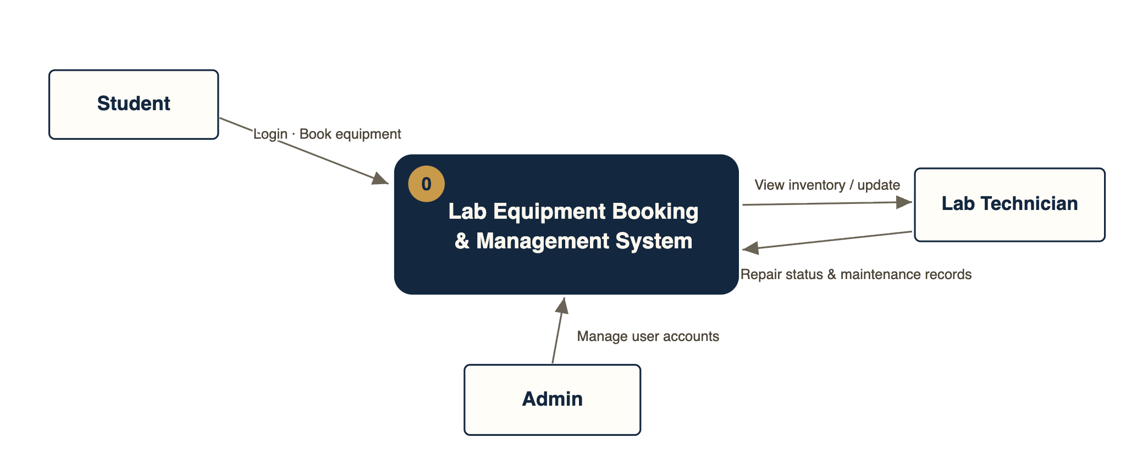
DFD — Level 0 (Context Diagram)
SYSTEM MODELLING
The system as a single process with its external entities
Notes:
This context diagram shows the whole system as one process. External entities — Student, Admin and Lab Technician — exchange data with it: students log in and book equipment, admins manage users, and technicians view inventory and update repair and maintenance status.

Slide 18
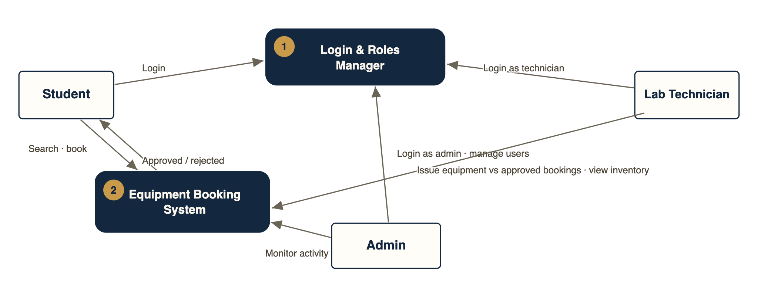
DFD — Level 1
SYSTEM MODELLING
Login & roles manager and the equipment booking process
Notes:
Level 1 breaks the single process into sub-processes. The Login and Roles Manager authenticates each role, the Equipment Booking System handles searching and booking, and flows show admins monitoring activity and technicians viewing inventory and issuing equipment against approved bookings.

Slide 19
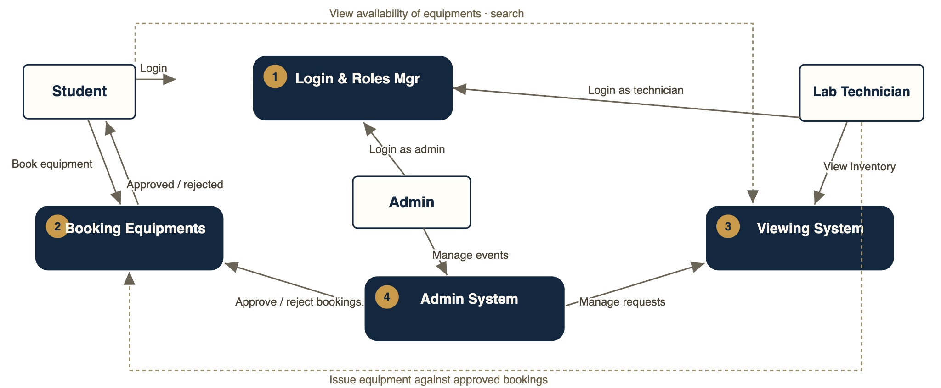
DFD — Level 2
SYSTEM MODELLING
Booking, viewing and administration data flows in detail
Notes:
Level 2 expands the detail further: it traces booking equipment against approved requests, approval and rejection flows, how the admin manages all events and accounts through the admin system, and how the viewing system surfaces inventory and request status.

Slide 20
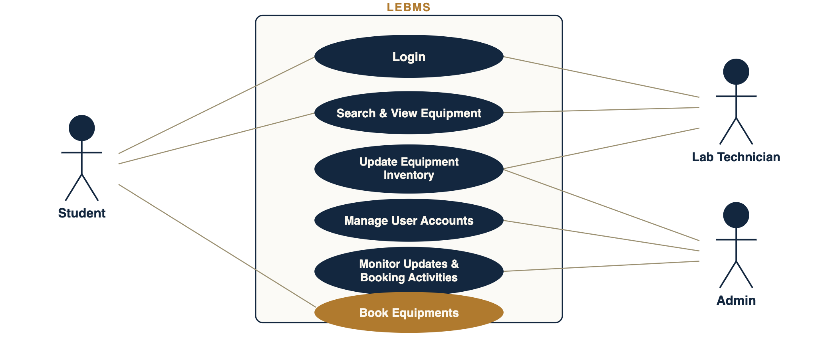
Use Case Diagram
SYSTEM MODELLING
Student, Lab Technician and Admin actors
Notes:
The use case model lists the actions each actor performs. Students log in, search and book equipment. Lab technicians log in, search, and update equipment inventory and current availability. Admins manage user accounts, monitor all booking activities and update equipment.

Slide 21
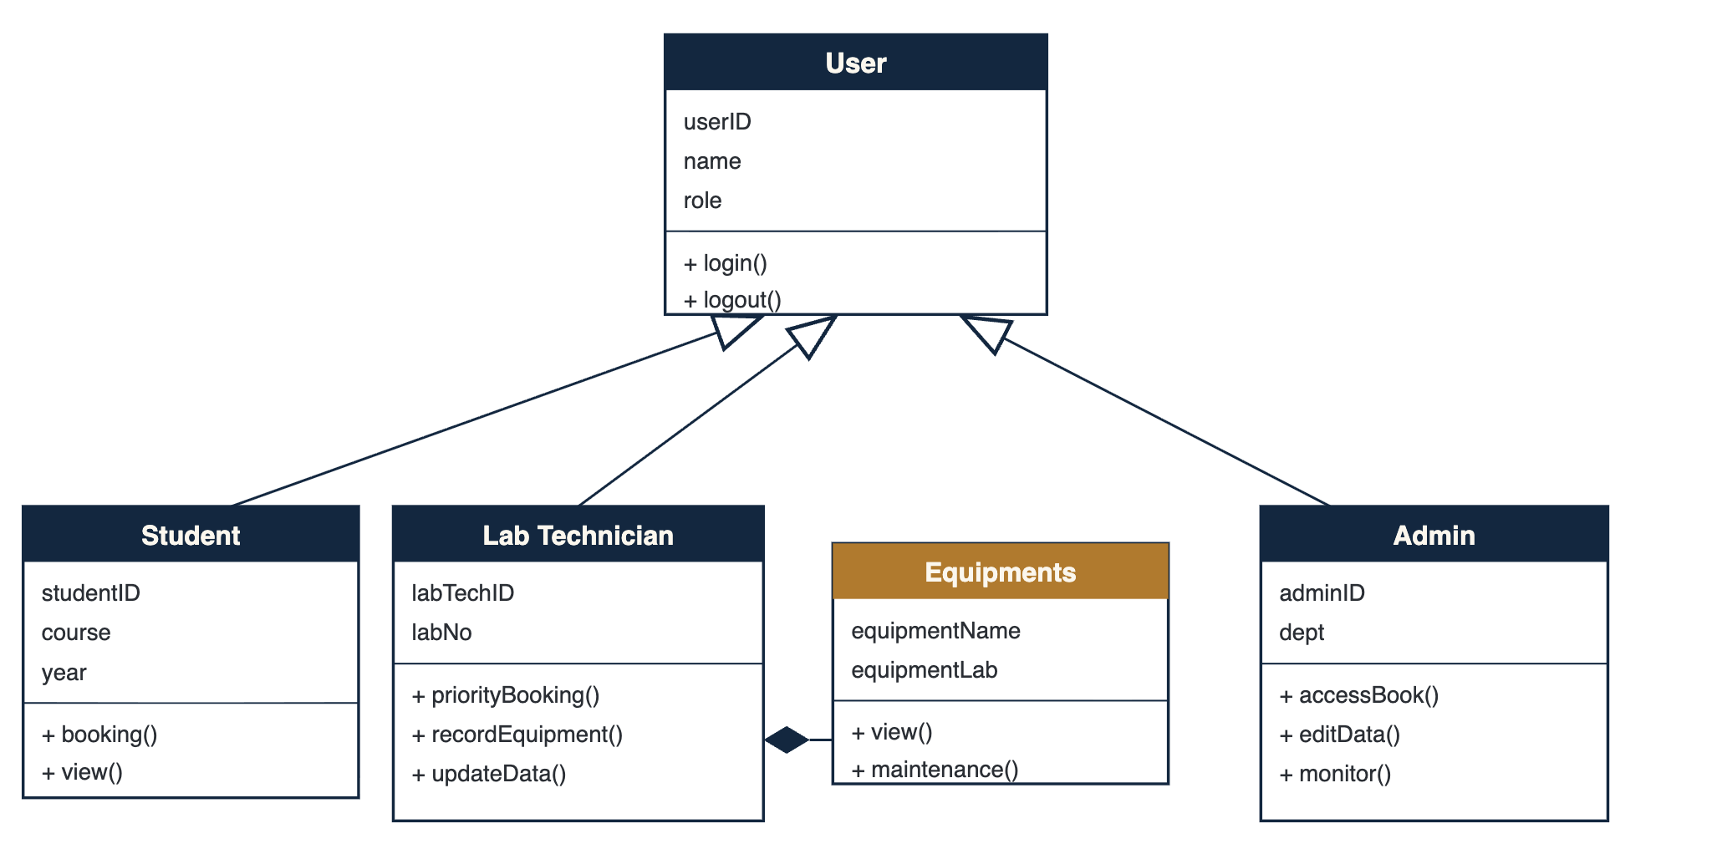
Class Diagram
SYSTEM MODELLING
User base class with Student, Lab Technician, Admin & Equipments
Notes:
The class diagram shows the object model. A base User class holds userID, name and role with login and logout methods. Student, Lab Technician and Admin inherit from it (open triangles), and the Equipments class — holding name, lab and maintenance operations — is linked by composition to Student and Lab Technician.

Slide 22
A reliable way to manage lab resources
CONCLUSION
LEBMS simplifies and automates the management of laboratory resources through a centralized platform for inventory, booking, usage tracking, returns and maintenance. It reduces manual recordkeeping, minimizes booking conflicts, improves availability tracking and ensures better accountability.
Future Enhancements
Automated notifications
QR-code-based equipment tracking
Integration with institutional management systems
Overall, the system promotes efficient utilization of equipment, simplifies administrative operations and provides a reliable approach to managing laboratory resources.
Lab Equipment Booking & Management System
Notes:
In conclusion, LEBMS centralizes and automates lab resource management, cutting manual work, booking conflicts and tracking gaps while improving accountability. Planned future enhancements include automated notifications, QR-code equipment tracking and integration with institutional management systems. Thank you.

